Slide 1
Digital Systems and Computer Architecture Session 3.1 Mouli Sankaran
Module 3
FSM, Moore and Mealy Models

Slide 2
Session 3.1: Focus
Finite State Machine (FSM)
Example: Turnstile
Types of Clocked Sequential Circuits
Moore Model
Mealy Model
Example circuits

Slide 3
Finite State Machine

Slide 4
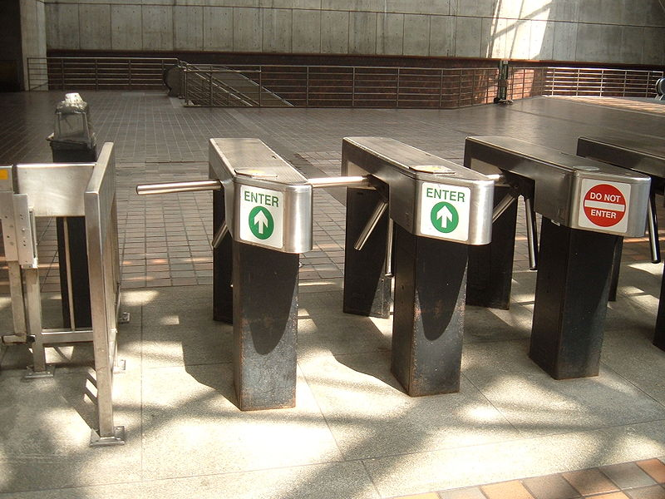
Example: Turnstile
Allows people to enter through only on one side. It can also have controlled access (coin) to let people in.

Slide 5
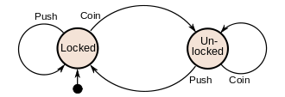
Operation of Turnstile Operation Explained
Inputs are:
1. Coin
2. Push
Operation is modeled with a State Machine or State Diagram
Turnstile can be in one of these two states
Locked
Unlocked
Initially it is in a Locked condition
Dropping a coin changes the state of the machine from Locked to Unlocked

Slide 6
Turnstile Operation Explained
In the unlocked state, when the cross bar is pushed
One person can move in through the gate
Turnstile changes back to Locked state
The cross bar cannot be moved in the locked state even if it gets pushed
There by allowing only maximum one person to enter for every coin dropped

Slide 7
Finite State Machine (FSM)
A Finite-State Machine (FSM) or Finite-state Automaton (FSA, plural: automata), finite automaton, or simply a state machine, is a mathematical model of computation.
It is an abstract machine that can be in exactly one of a finite number of states at any given time.
The FSM can change from one state to another in response to some external inputs; the change from one state to another is called a transition.
A FSM is defined by a list of its states, its initial state, and the conditions for each transition.

Slide 8
FSM of Turnstile
Dark dot here
Shows the
Initial state
List of states
Locked
Unlocked
Initial State: Locked
External Inputs: Coin and Push
Transitions:
Locked to Unlocked (Condition: Dropping of coin)
Unlocked to Locked (Condition: Pushing the bar)

Slide 9
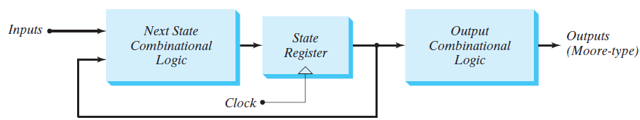
a) Moore Model
In the Moore model, the output is a function of only the present state.
Present states are in tern driven by the inputs

Slide 10
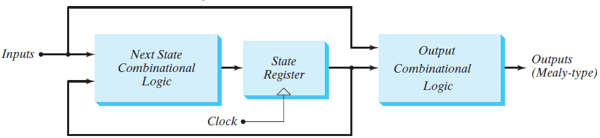
b) Mealy Model
In the Mealy model, the output is a function of both the present state and the inputs.
A circuit may also have both types of outputs.
i.e., both Mealy and Moore type of outputs

Slide 11
Mealy and Moore Machines
These two models of sequential circuits are commonly referred to as a Finite State Machine, abbreviated FSM.
The Mealy model of a sequential circuit is referred to as a Mealy FSM or Mealy machine.
The Moore model is referred to as a Moore FSM or Moore machine.

Slide 12
Session 3.1: Summary
Finite State Machine (FSM)
Example: Turnstile
Types of Clocked Sequential Circuits
Moore Model
Mealy Model

